Slide 1
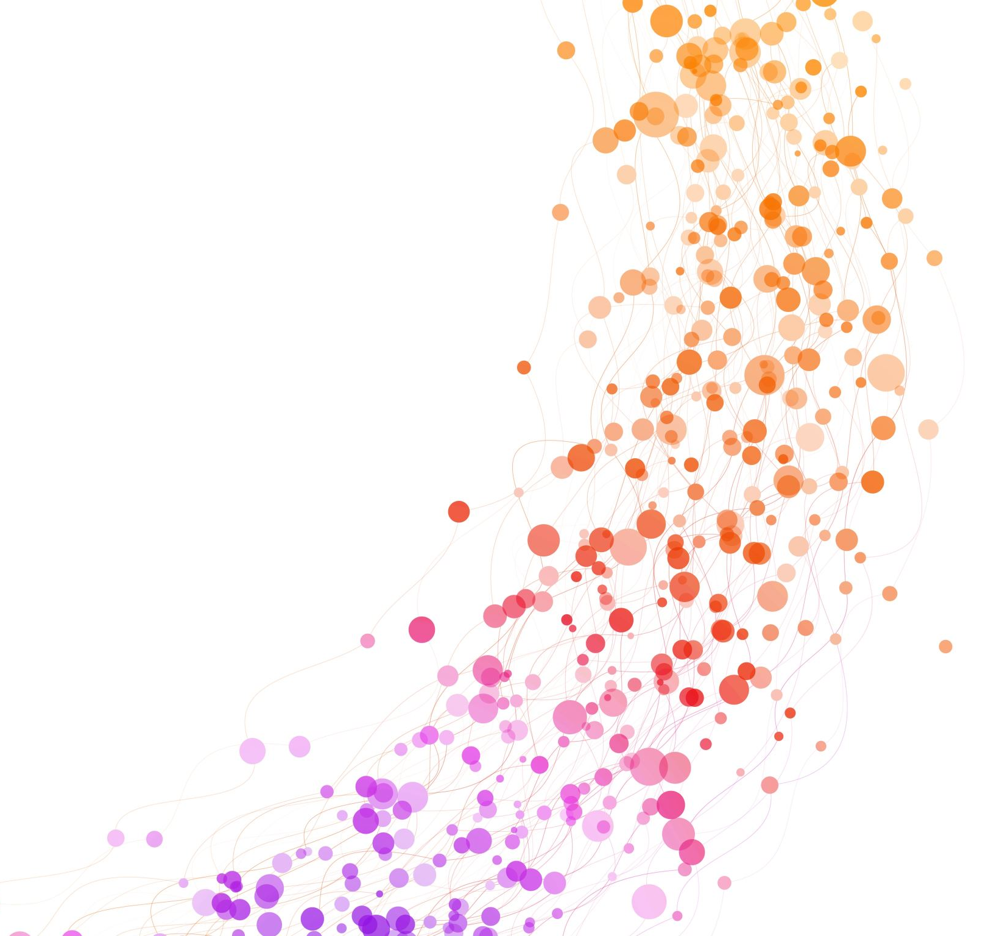
NLP for MIMIC: Tutorial For Liver Data Analysis
Jesus Minjares
UT AUSTIN: AI in HEALTHCARE

Slide 2
Overview
Load and Filter Data
SpaCy for NLP Processing
SciSpaCy for Biomedical Text
Word2Vec for Medical Embeddings
t-SNE for Dimensionality Reduction
MedSpaCy for Clinical NLP

Slide 3
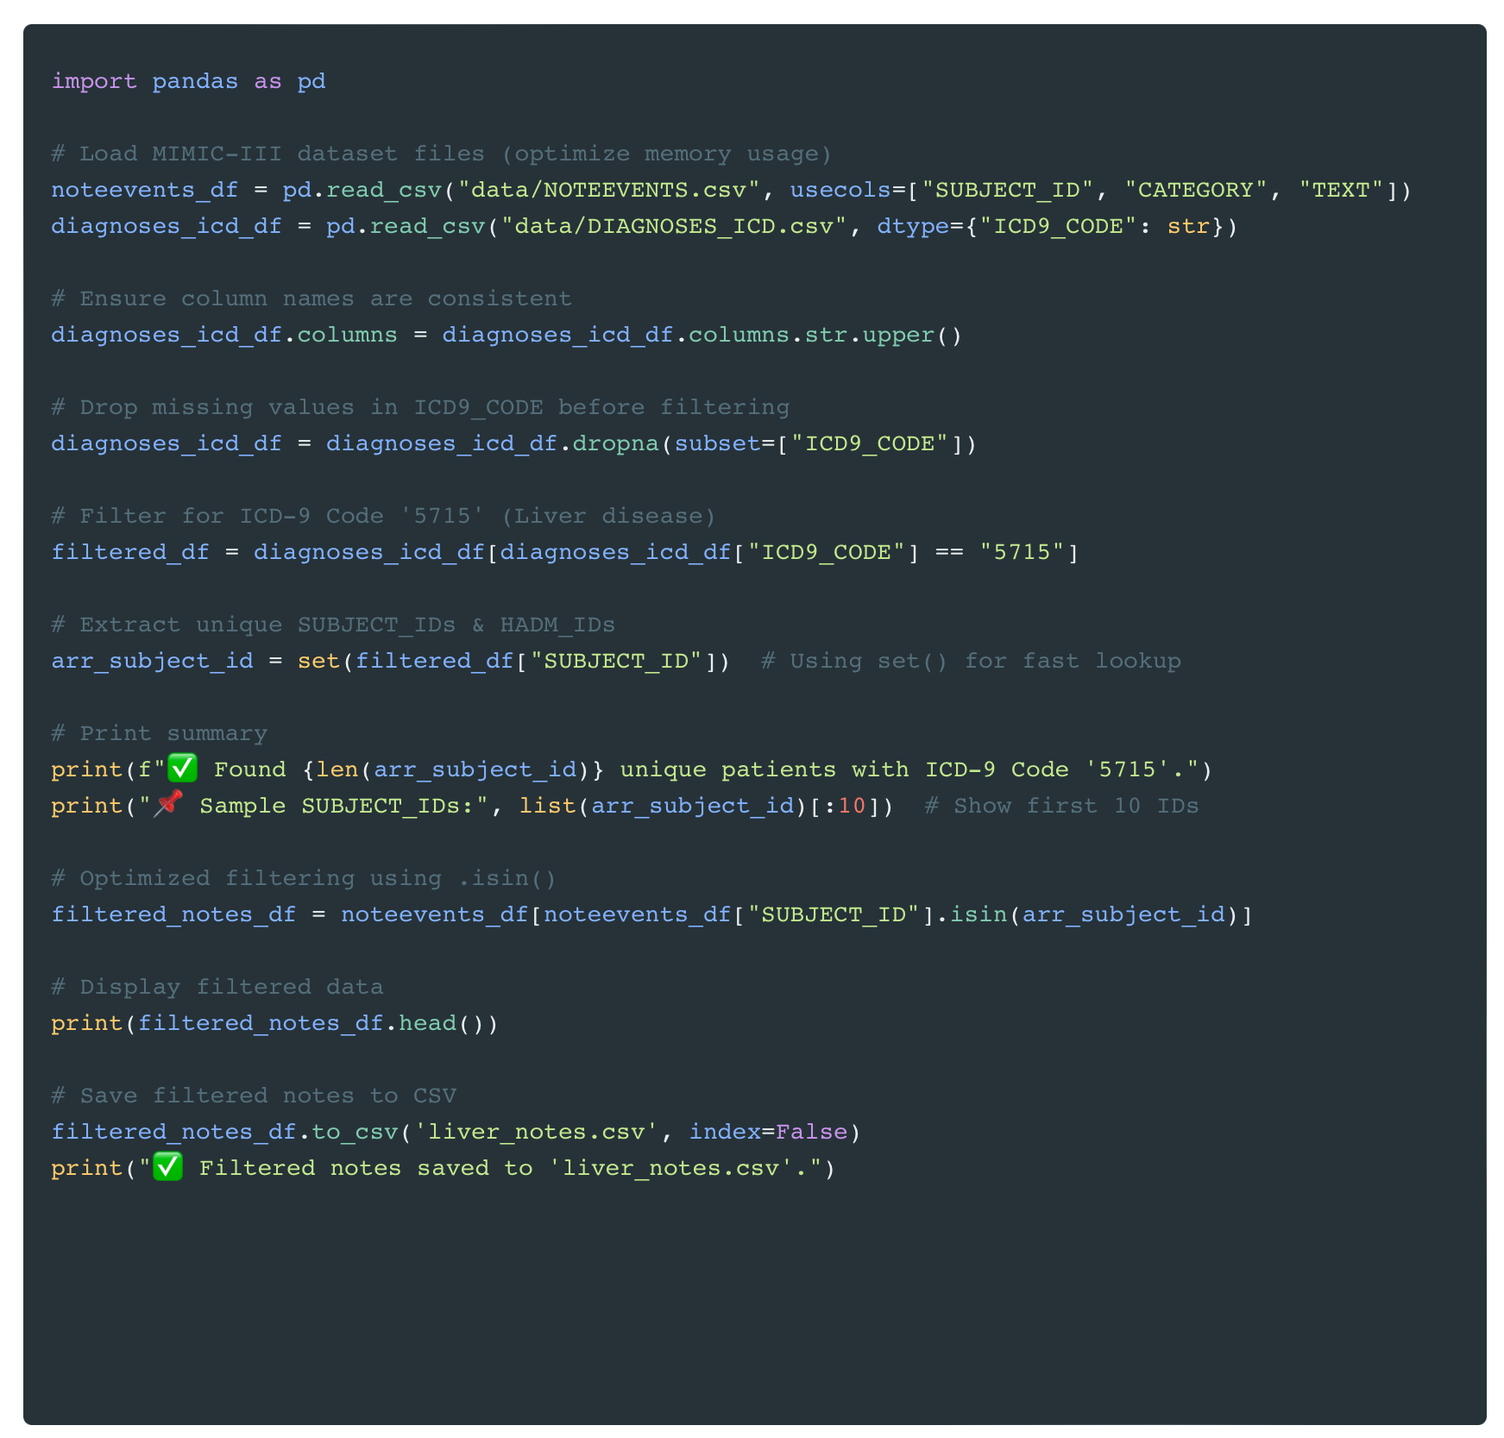
Load and Filter Data
Overview This script filters and extracts clinical notes for patients diagnosed with ICD-9 Code 5715 (Liver Disease) from the MIMIC-III dataset.
Process
Load Data Efficiently – Reads NOTEEVENTS.csv (clinical notes) and DIAGNOSES_ICD.csv (diagnoses) with optimized memory usage.
Standardize and Clean Data – Ensures consistent column names and removes missing values.
Filter for Liver Disease – Selects records where ICD-9 Code = 5715 and extracts SUBJECT_IDs.
Retrieve Clinical Notes – Matches SUBJECT_IDs to corresponding notes.
Save Processed Data – Stores the filtered notes in 'liver_notes.csv' for NLP analysis.
Outcome
X unique liver disease patients identified.
Dataset ready for NLP processing using SpaCy, SciSpaCy, Word2Vec, and MedSpaCy.

Slide 4
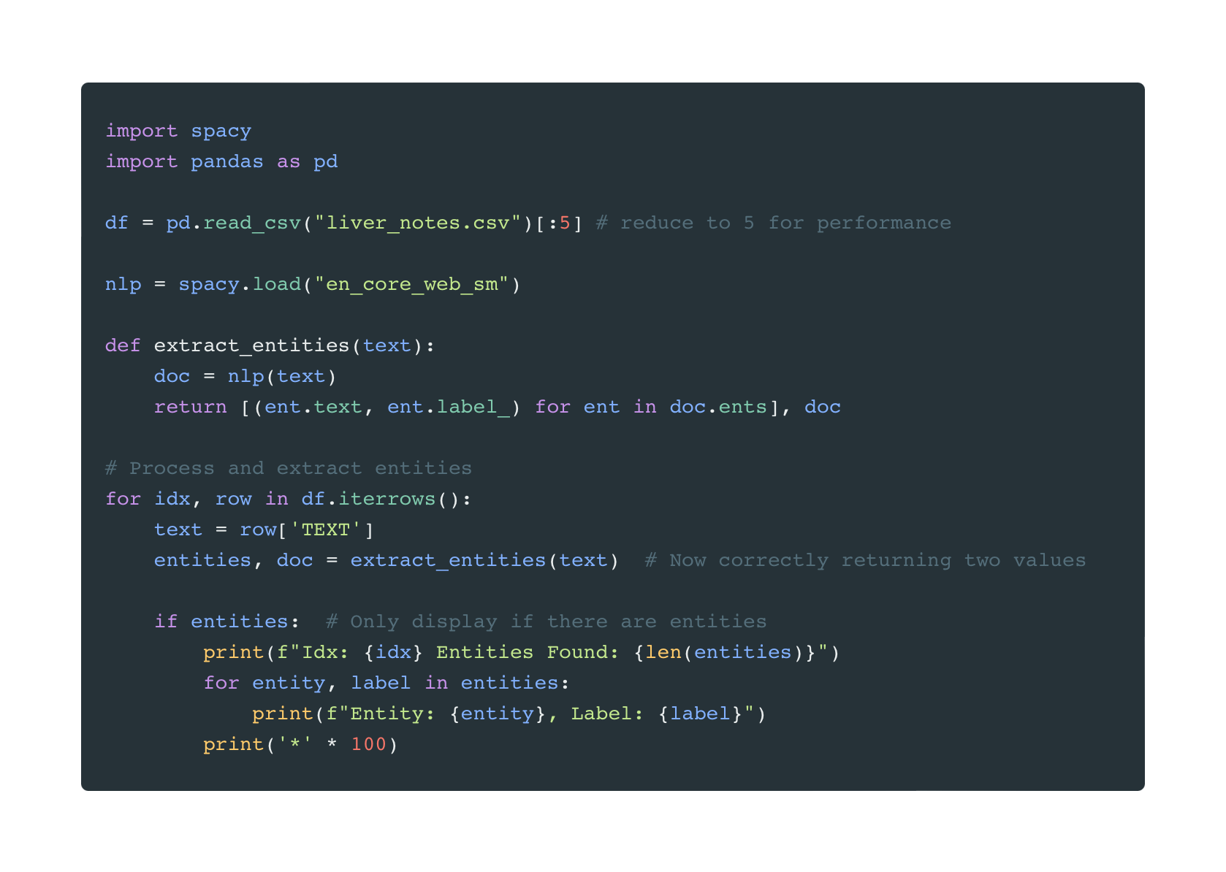
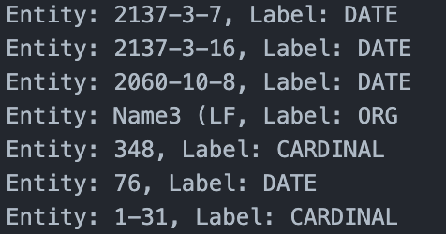
SpaCy
This script extracts named entities from clinical notes using SpaCy. It loads the first five rows of liver_notes.csv, processes text with en_core_web_sm, and prints detected entities with their labels.
Output:

Slide 5
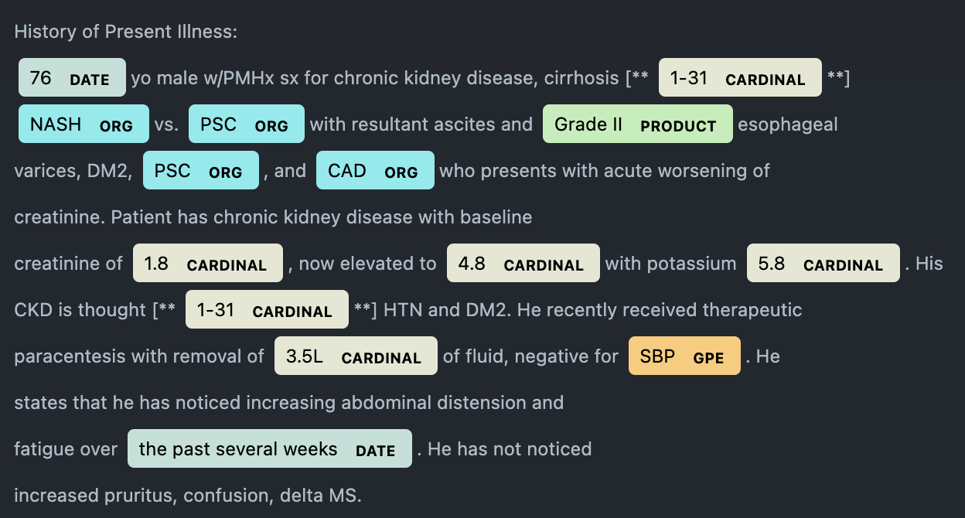
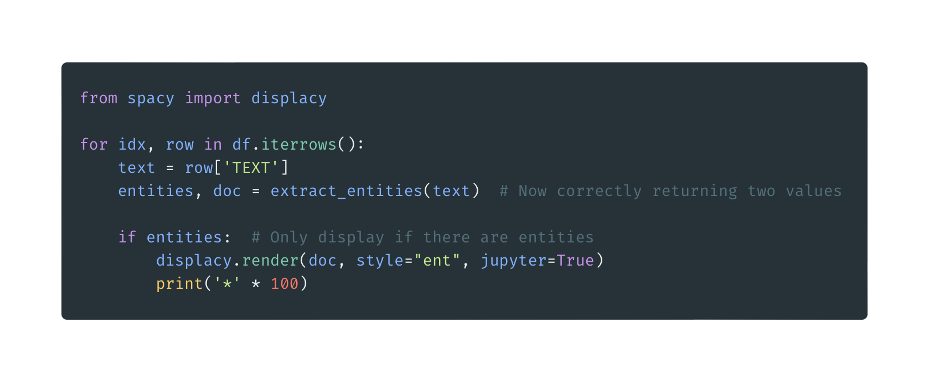
SpaCy with NER
This script visualizes NER (Named Entity Recognition) in liver_notes.csv using displaCy.

Slide 6
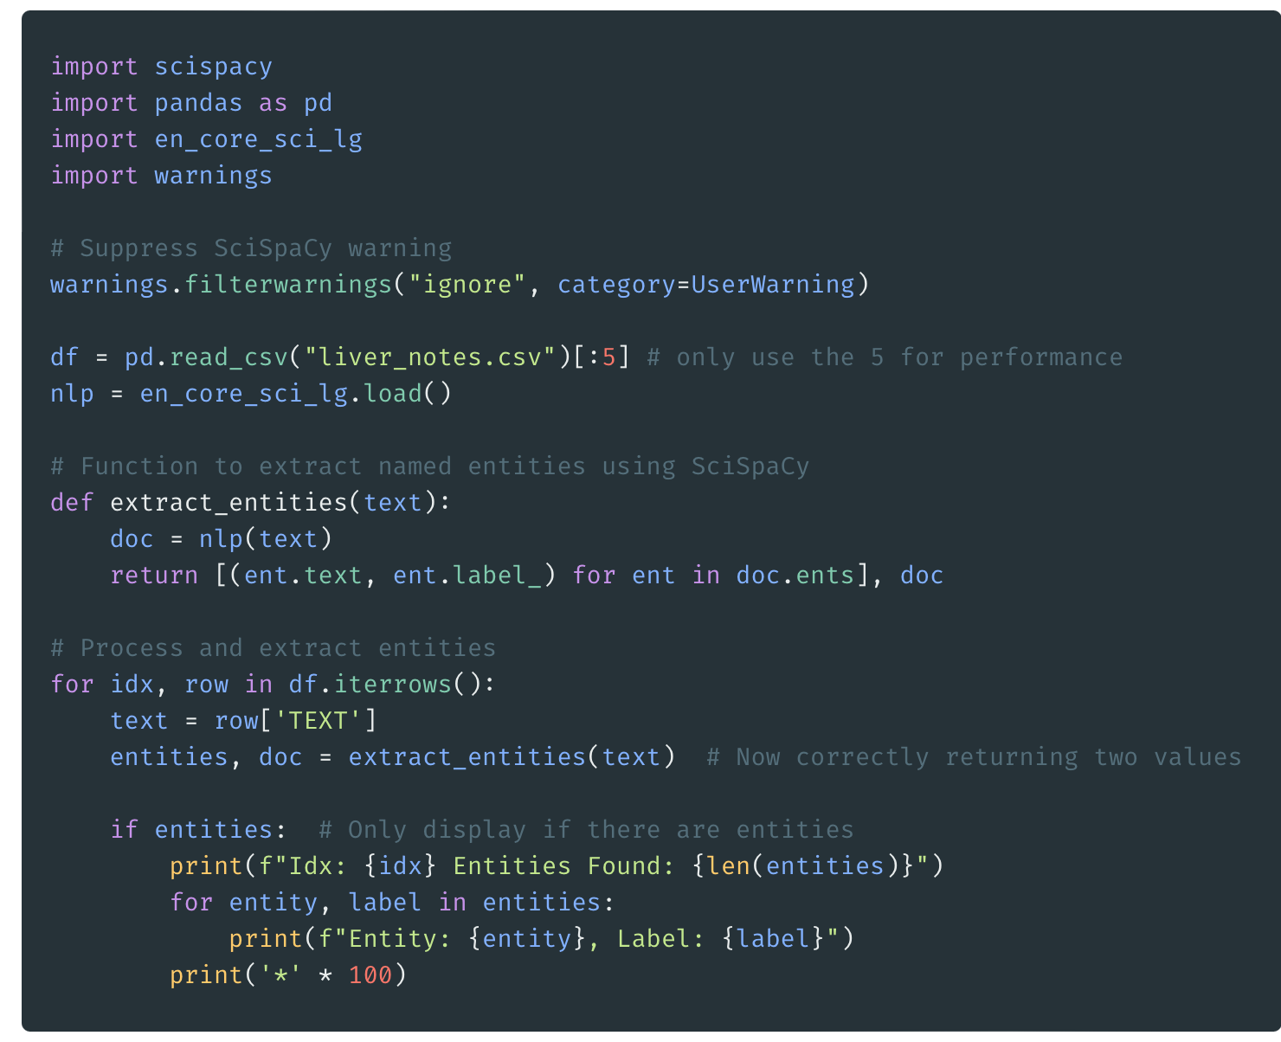
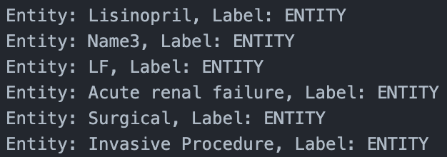
SciSpaCy
This script extracts named entities from clinical notes using SciSpaCy. It loads the first five rows of liver_notes.csv, processes text with en_core_sci_lg, and prints detected entities with their labels.

Slide 7
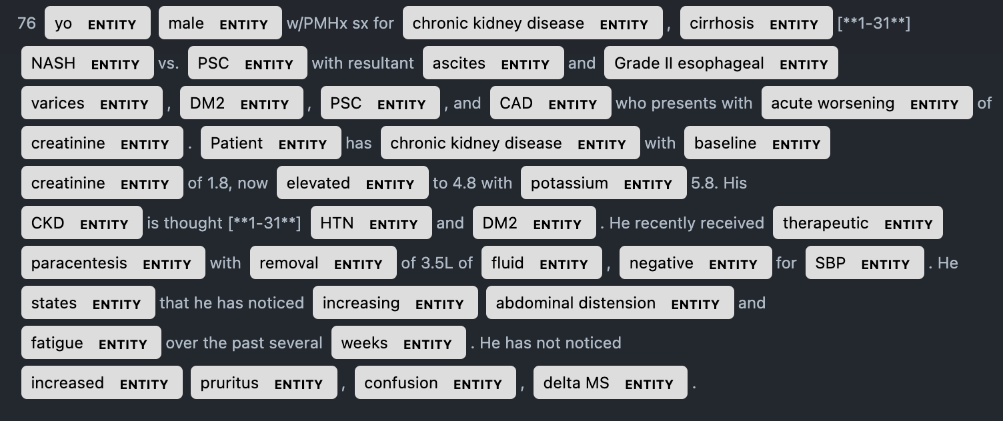
SciSpaCy with NER
This script visualizes NER (Named Entity Recognition) in liver_notes.csv using displaCy.

Slide 8
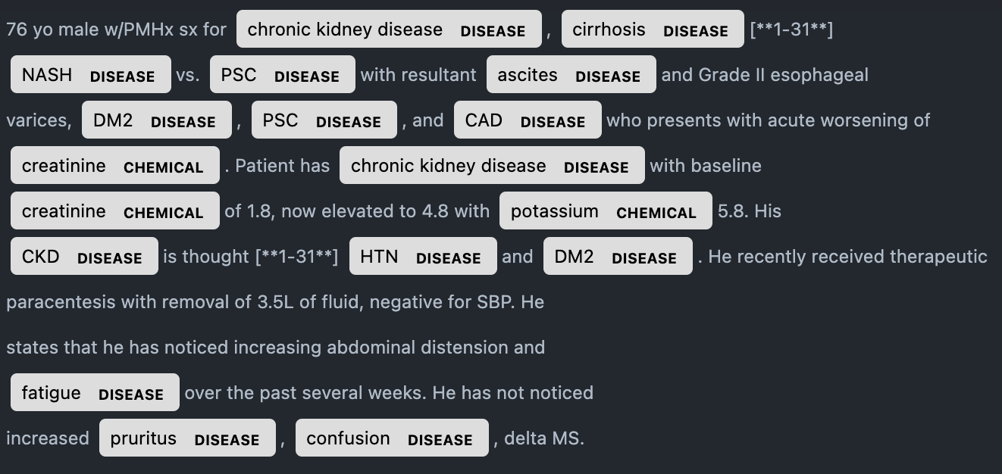
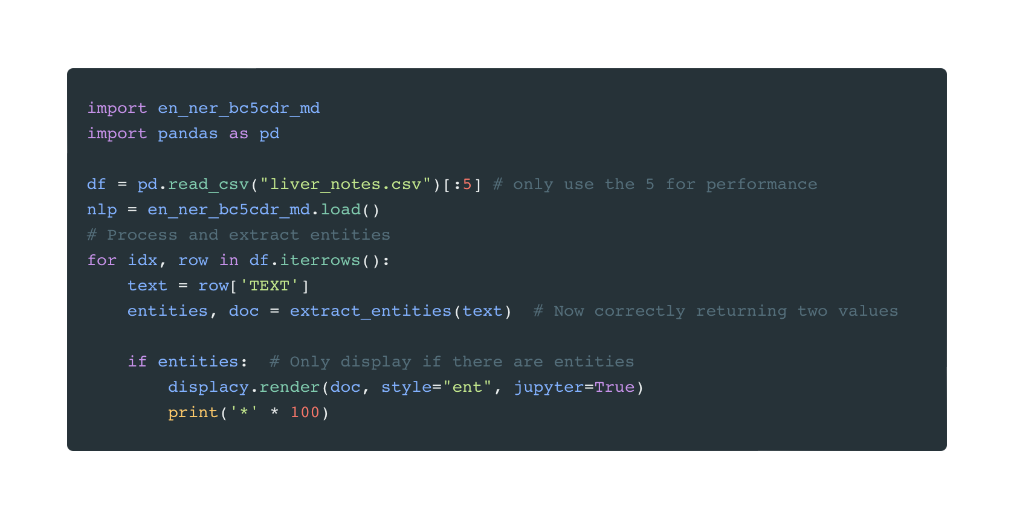
SciSpaCy with NER cont.
This script extracts named entities from clinical notes using SciSpaCy using en_ner_bc5cdr_md model.

Slide 9
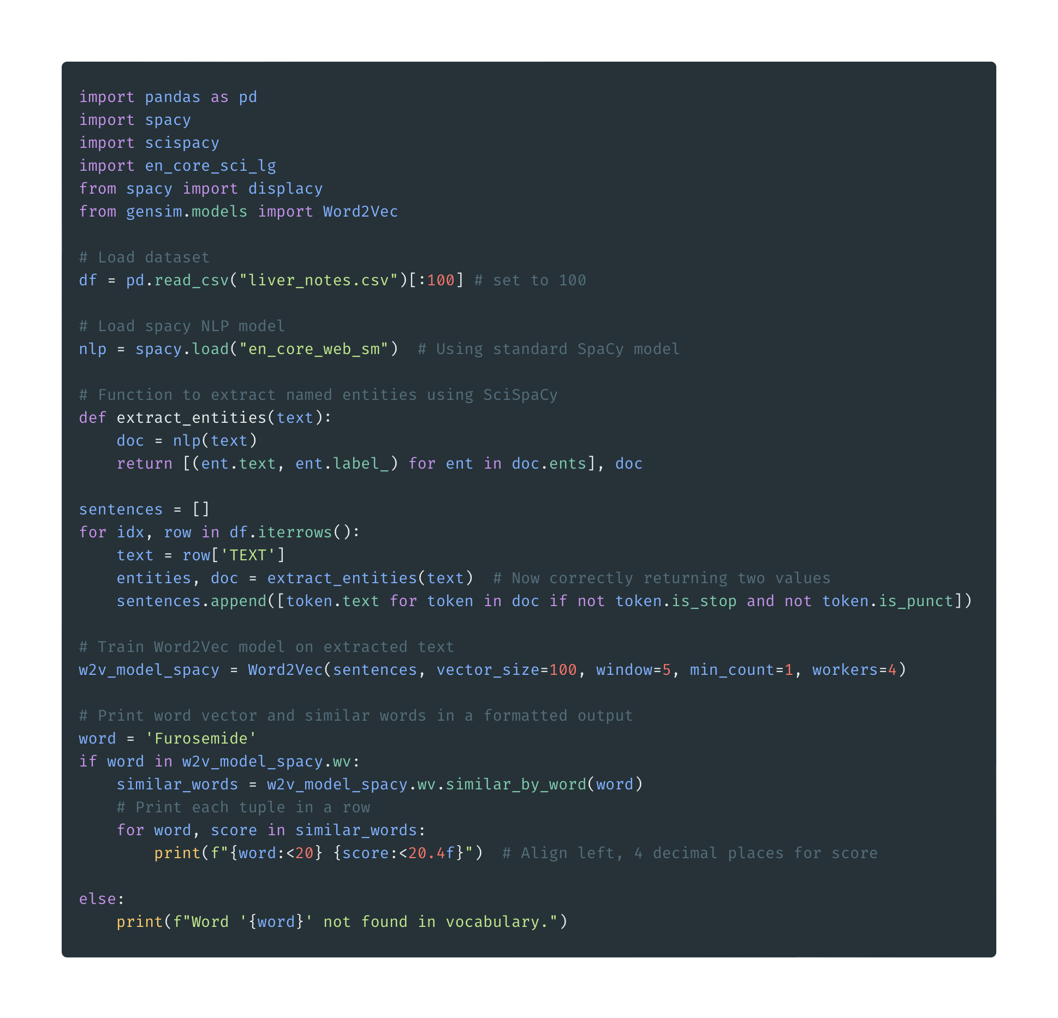
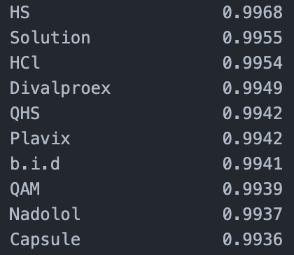
Word2Vec with SpaCy
This script extracts named entities, tokenizes text, and trains a Word2Vec model on liver_notes.csv using SpaCy. It then finds similar words for a given medical term.
Output:

Slide 10
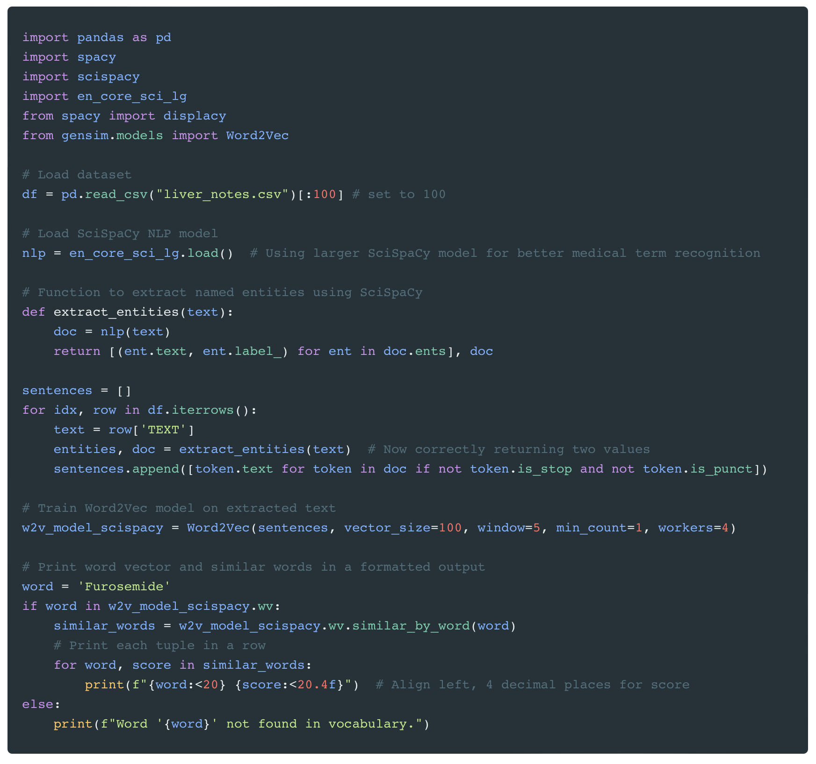
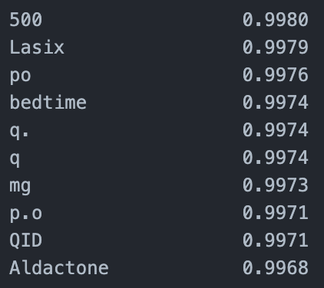
Word2Vec with SciSpaCy
This script extracts named entities, tokenizes text, and trains a Word2Vec model on liver_notes.csv using SciSpaCy. It then finds similar words for a given medical term.
Output:

Slide 11
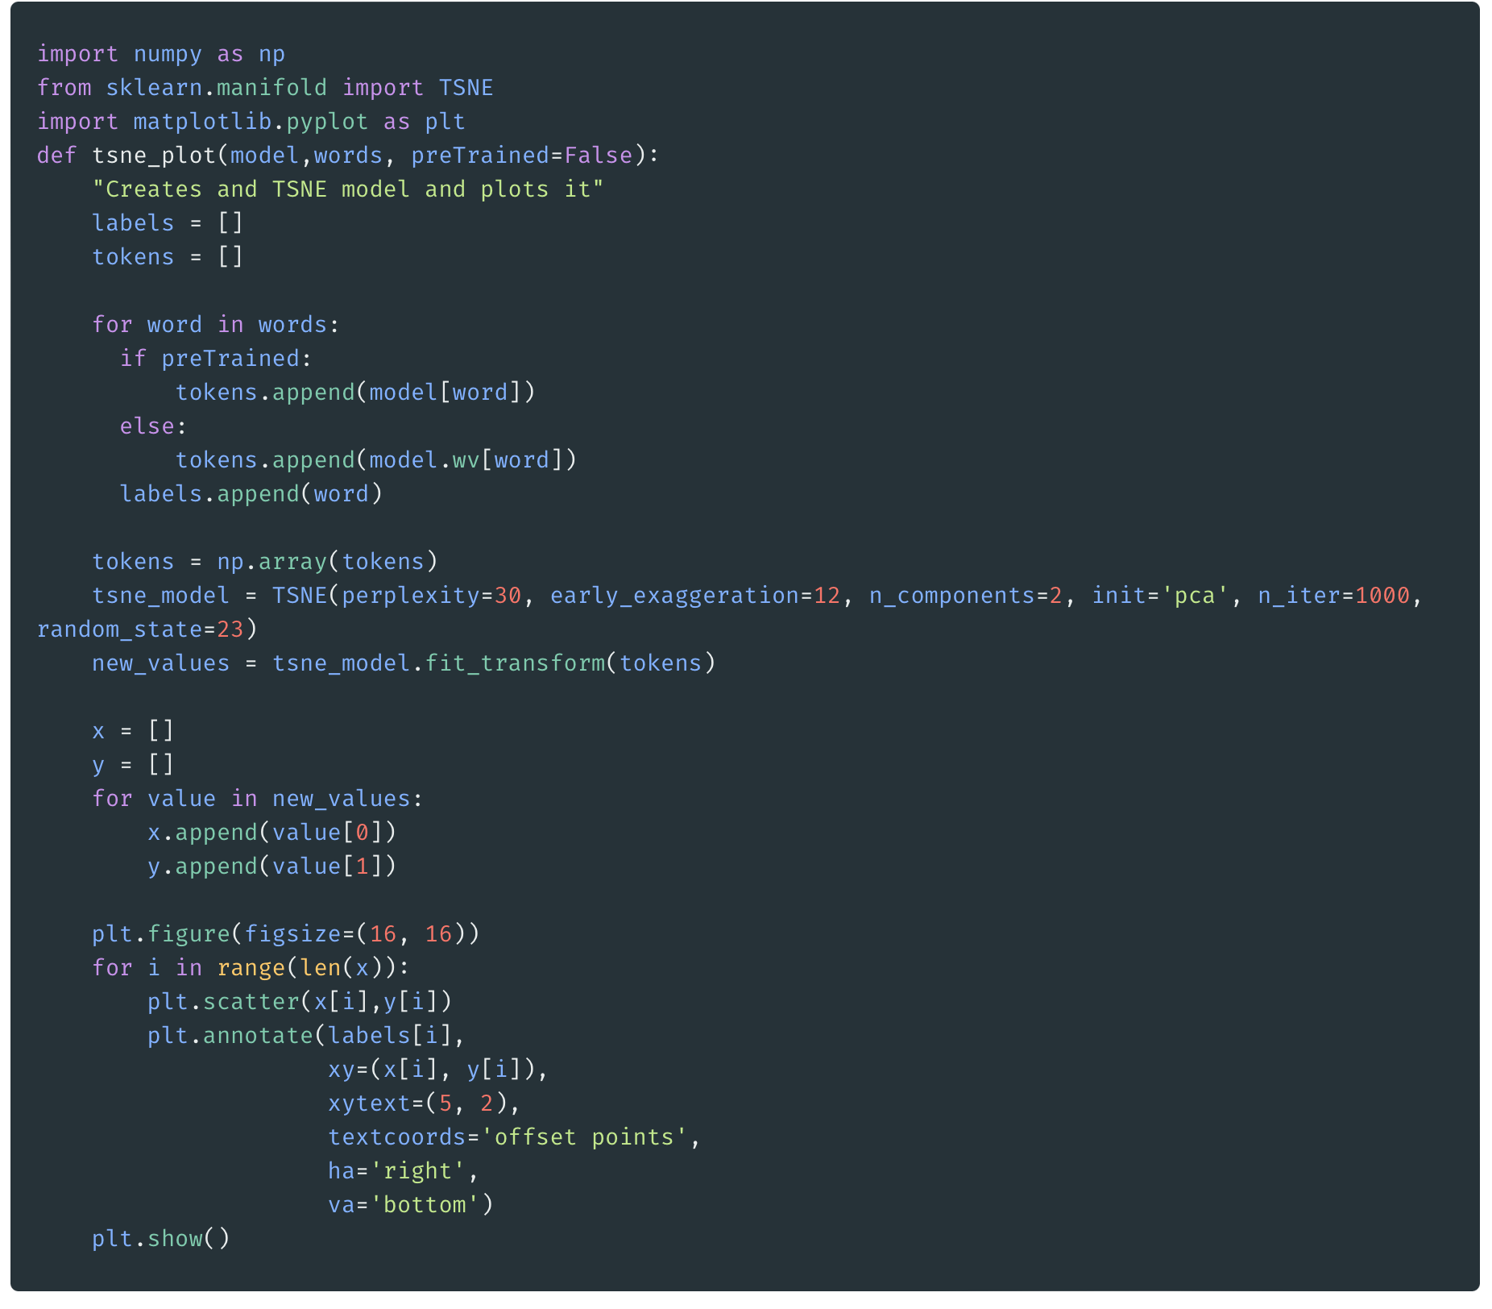
t-SNE
This code uses t-SNE to reduce word embeddings to 2D space, then plots them with Matplotlib, labeling each word to visualize relationships and clustering patterns.

Slide 12
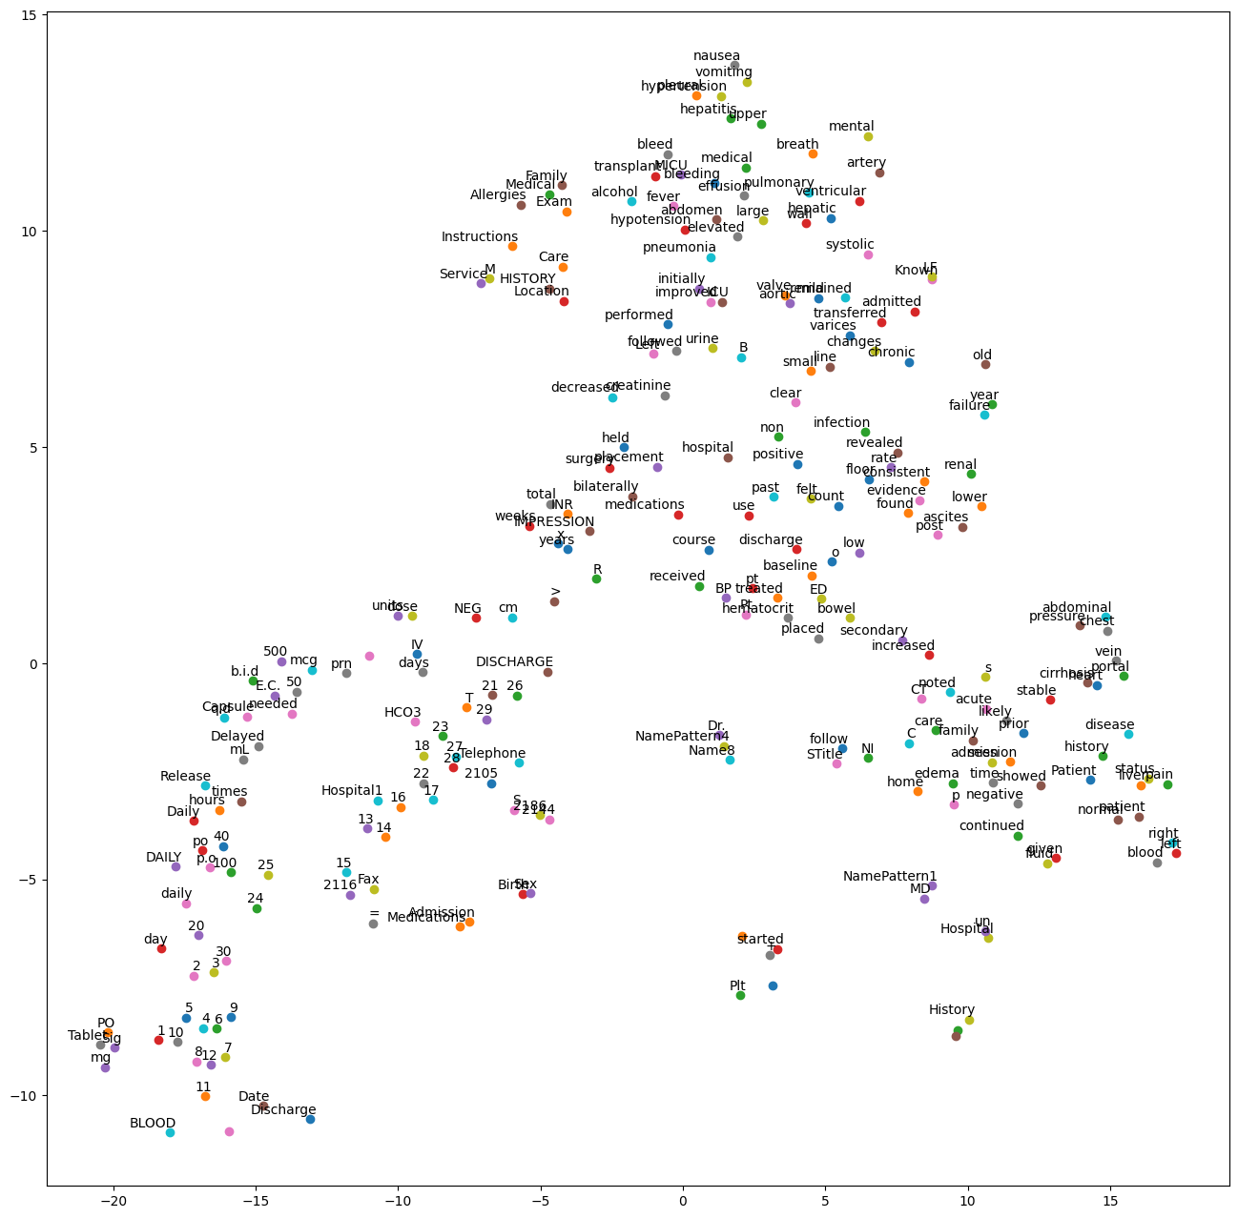
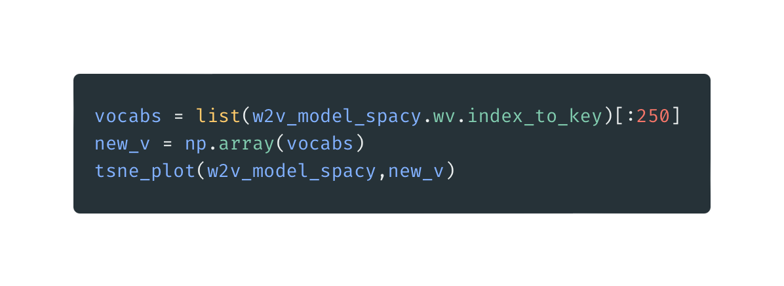
t-SNE: SpaCy
This code selects the top 250 words from the SpaCy-based Word2Vec model, converts them into a NumPy array, and visualizes their embeddings using t-SNE.

Slide 13
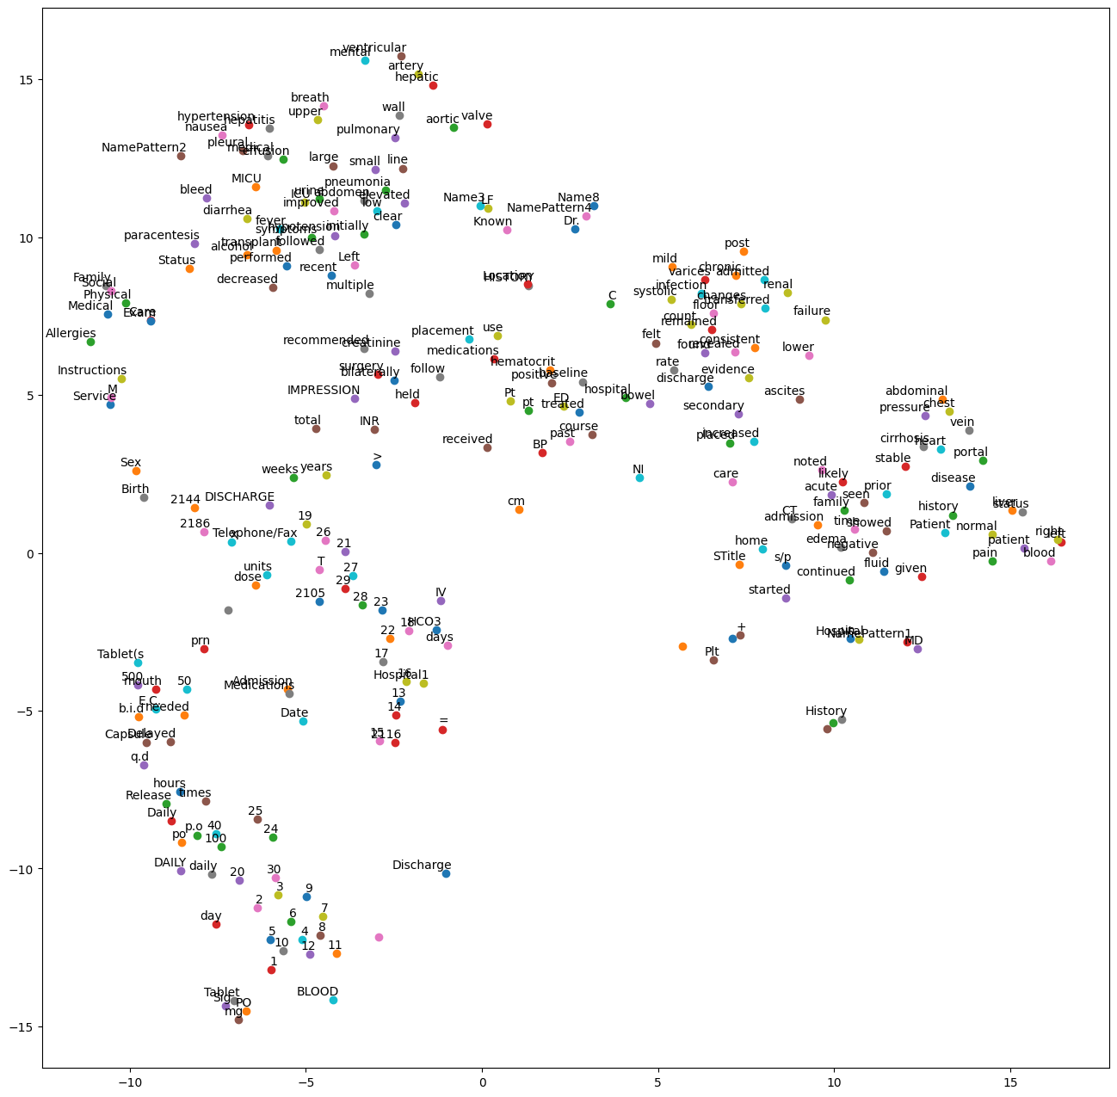
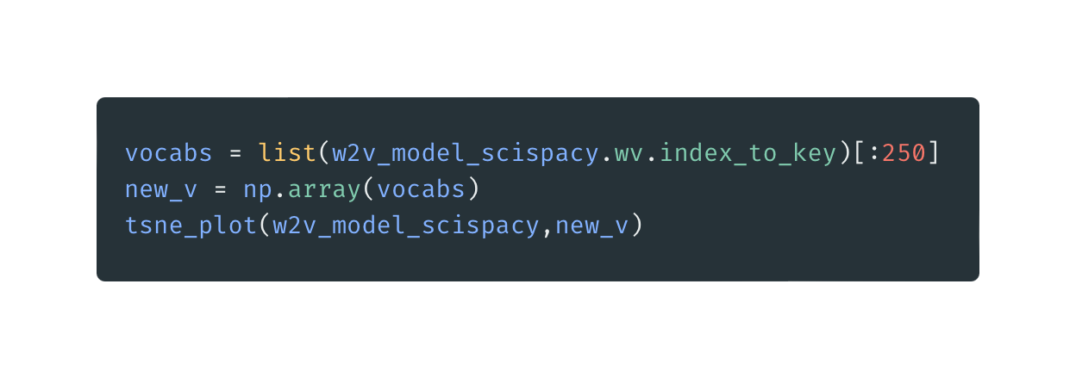
t-SNE: SciSpaCy
This code selects the top 250 words from the SciSpaCy -based Word2Vec model, converts them into a NumPy array, and visualizes their embeddings using t-SNE.

Slide 14
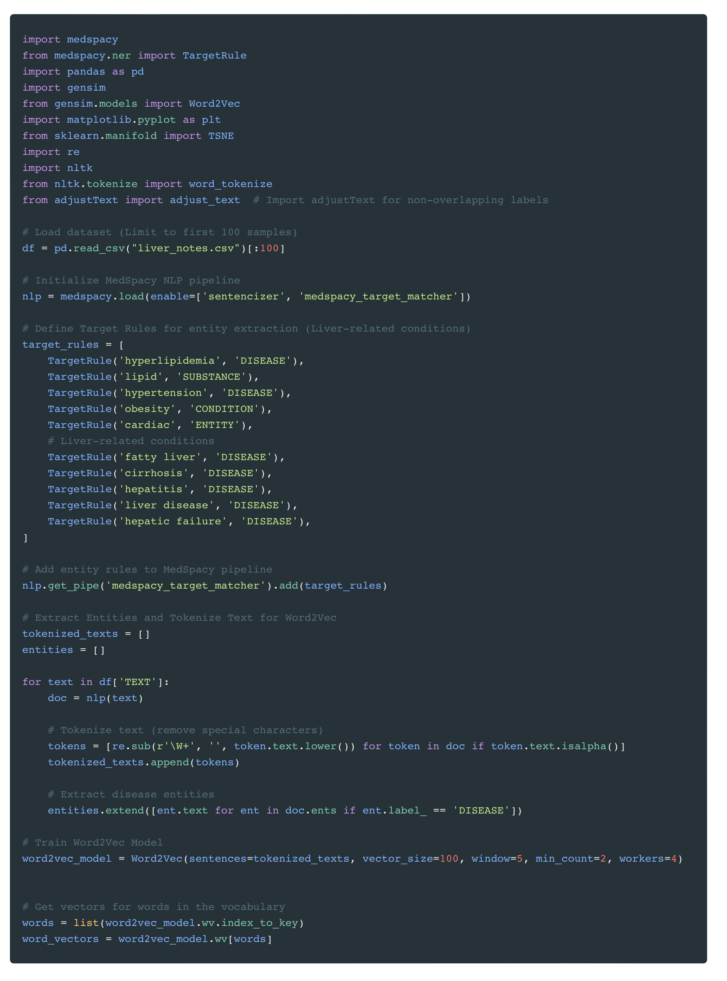
MedSpaCy
This script uses MedSpaCy to extract medical entities from clinical notes, tokenizes the text, and trains a Word2Vec model to generate word embeddings, which serve as the vocabulary for t-SNE visualization.

Slide 15
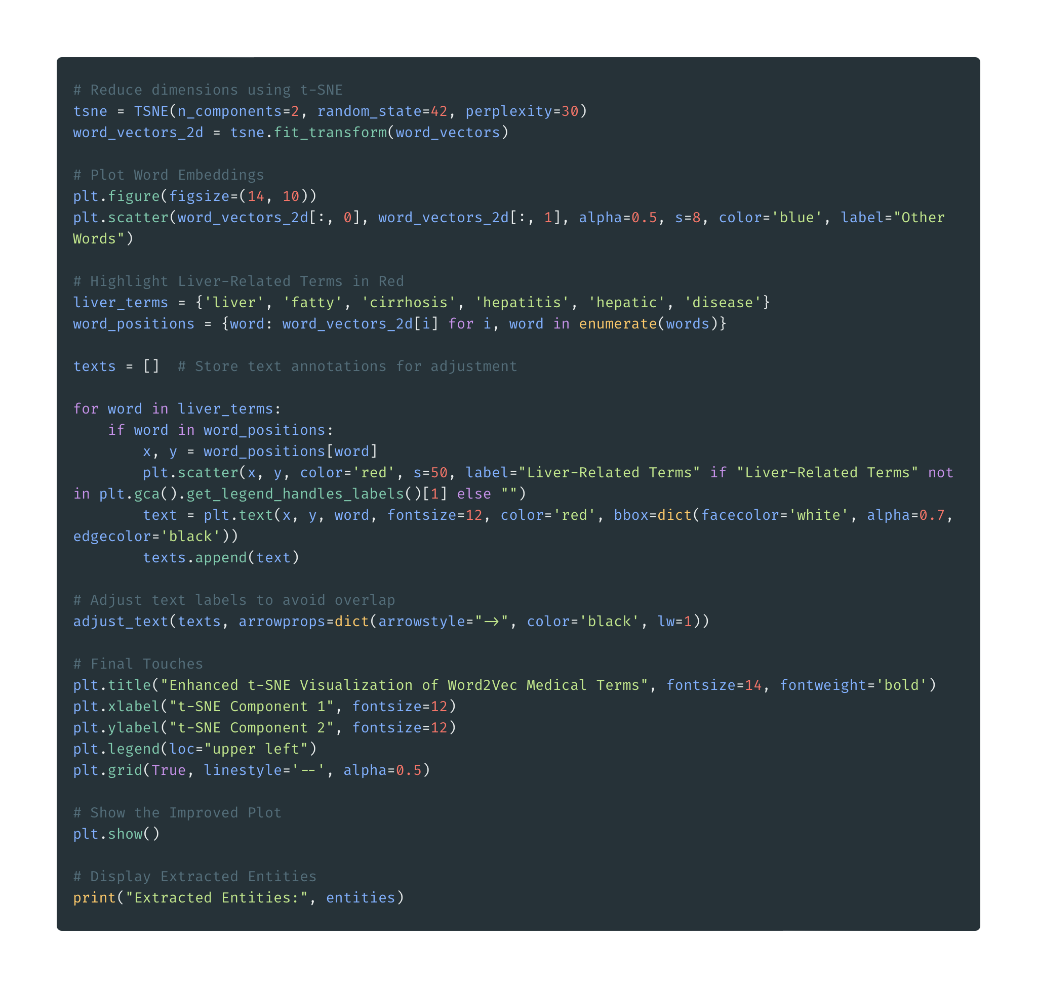
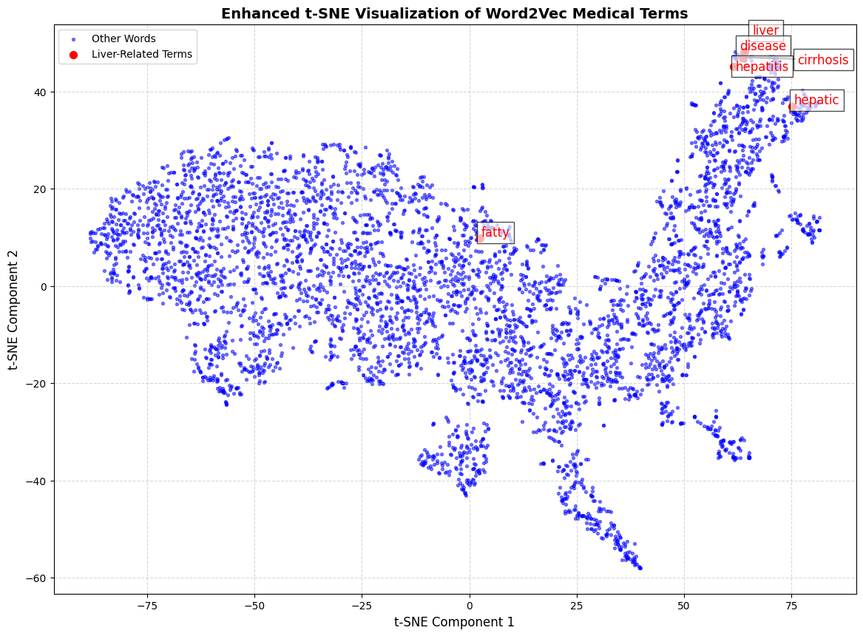
MedSpaCy TSNE Plot

